Slide 1
Supporting Individuals – What support is available for individuals seeking employment?

Slide 2
Introduction

Slide 3
Schedule
Why are we having this discussion?
Support Available – Access to Work
What employers are doing – workplace guides, adjustments
Skills Development and Opportunities - Success Stories
Disclosing to employers
The changing workplace
Resources available to support

Slide 4
Why are we having this discussion?
Changing nature of the workplace and recruitment
Skilled Workforce – The Business Benefits
Statistics

Slide 5
Background information
1 in 50 People Have Learning Disability
Just 6% are in employment
7.7 Million working age people in the UK have a disability

Slide 6
Barriers to employment
Physical Factors
Recruitment and Selection
Job Opportunities
Environmental Factors

Slide 7
Available support

Slide 8
https://www.youtube.com/watch?v=2eAN-_5yK9c
Disability Confident Video

Slide 9
Levels of Disability confident
It is voluntary and has been developed by employers and disabled people’s representatives. The Disability Confident scheme has three levels that have been designed to support organisations:
Level 1: Disability Confident Committed
Level 2: Disability Confident Employer
Level 3: Disability Confident Leader

Slide 10
Access to work
An Access to Work grant can pay for practical support to help you:
start working
stay in work
move into self-employment or start a business

Slide 11
Access to work
How can it help me?
Access to Work can help pay for support you may need because of your disability or long term health condition, for example:
aid and equipment in your workplace
adapting equipment to make it easier for you to use
money towards any extra travel costs to and from work if you can’t use available public transport, or if you need help to adapt your vehicle
an interpreter or other support at a job interview if you have difficulty communicating
other practical help at work, such as a job coach or a note taker or lip speaker

Slide 12
How does it work?
Individual and Company agree to Access to work
Individual Applies
Judgement from Access to Work
Funding Allocated
Support Begins
Invoice from Training Partner Paid
Expenses paid back to company by Access to work

Slide 13
Current Example
Existing Employee
1 hour per week Mentoring for Employee
1 hour per month support for Employer
Training Course for Colleagues and Managers (3 Hr)
Payments

Slide 14
Application process
Individual Details
Job Details
Does your condition make it harder for you to do your job?
Do you do anything to get around these problems at the moment?
Do you know what you need to help you with this?
Travel/Transport

Slide 15
Reasonable adjustments

Slide 16
Reasonable adjustments
“Employers must make reasonable adjustments to make sure workers with disabilities, or physical or mental health conditions, aren’t substantially disadvantaged when doing their jobs.
This applies to all workers, including trainees, apprentices, contract workers and business partners.”
1-2-1 training rather than group training
Controllable Lights
Sunglasses in the workplace
Small Changes = Life Changing Differences

Slide 17
Reasonable Adjustments
changing the recruitment process so a candidate can be considered for a job
doing things another way, such as allowing someone with social anxiety disorder to have their own desk instead of hot-desking
making physical changes to the workplace, like installing a ramp for a wheelchair user or an audio-visual fire alarm for a deaf person
changing their equipment, for instance providing a special keyboard if they have arthritis
allowing employees who become disabled to make a phased return to work, including flexible hours or part-time working

Slide 18
https://www.youtube.com/watch?v=1NQ5sx6QhUQ
Jonathan’s Story
Video

Slide 19
What are businesses doing to help?

Slide 20
Small Changes
Workplace Guides
Interview Process
Matching up skills to jobs
Training and Support
Focus on what can be done
Environment

Slide 21
Recruitment and selection
Job Carving
Job Advertisements
Communication
Interviews
Work Trial

Slide 22
Skills development and opportunities

Slide 23
Skills and qualities
technical ability
detailed factual knowledge and an excellent memory
A different perspective
high levels of concentration
Hardworking and reliability
accuracy, close attention to detail and the ability to identify errors

Slide 24
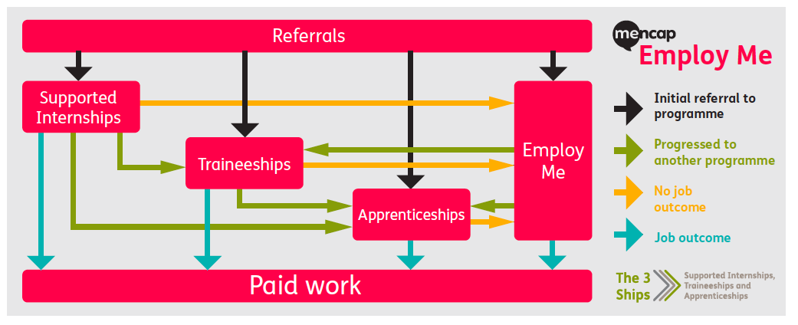
Routes into employment
Supported Internships
Traineeships
Apprenticeships
Voluntary Work
Organisations

Slide 25
The changing workplace

Slide 26
Changing workplace
Working from home
Opportunities
Hours of Work
Unwritten Rules

Slide 27
IN review
Support is available
Businesses are willing to make adjustments
Considering different routes into employment
Small environmental changes can make a life changing difference

Slide 28
Further resources
Into Apprenticeships
https://www.youtube.com/user/DisabilityRightsUK1
Into Higher Education Guide here

Slide 29
Further resources
DR UK Website
www.disabilityrightsuk.org
DR UK Work related factsheets and guides
https://www.disabilityrightsuk.org/how-we-can-help/benefits-information/factsheets/work-related-factsheets
https://www.disabilityrightsuk.org/news/2016/april/good-practice-supporting-disabled-learners
Get Ahead
https://www.disabilityrightsuk.org/get-ahead
Access to Work
https://www.gov.uk/access-to-work

Slide 30
The right to participate - animated introduction to the Equality Act, videos of campaigns, information and template complaint letters to protect disabled people from discrimination in everyday situations
http://righttoparticipate.org/

Slide 31
Question and Answer
Thomas@track.org,uk
Website: www.track.org.uk
Facebook: @TRACKnnLtd
Twitter: @TRACKnnLtd

